Slide 1
㈜대한랩테크
Notes:
Custom animation effects: dotted line with text fade by letter
(Basic)
To reproduce the text effects on this slide, do the following:
On the Home tab, in the Slides group, click Layout, and then click Blank.
On the Insert tab, in the Text group, click Text Box, and then on the slide, drag to draw a text box that spans the entire width of the slide.
On the Insert tab, in the Text group, click Symbol. In the Symbol dialog box, do the following:
In the Font list, select (normal text).
In the Subset list, select General Punctuation.
In the Character Code box, enter 2022 to select BULLET, and then click Insert.
Click Insert 33 more times until there is a row of 34 bullets in the text box.
In the text box, select the text, and then on the Home tab, in the Font group do the following:
In the Font list, select Arial Black.
In the Font Size list, select 44.
Click the arrow next to Font Color, and then under Theme Colors click White, Background 1 (first row, first option from the left).
On the Home tab, in the Drawing group, click Arrange, point to Align, and then do the following:
Click Align to Slide.
Click Align Center.
Click Align Middle.
On the Insert tab, in the Text group, click Text Box. Drag to draw a text box on the slide.
Enter and select the text. On the Home tab, in the Font group, do the following:
In the Font list, select Corbel.
In the Font Size box, enter 50.
Click the arrow next to Font Color, and then under Theme Colors click White, Background 1 (first row, first option from the left).
Click Bold.
With the text still selected, on the Home tab, in the Paragraph group, click Center.
Select the second text box. On the Home tab, in the Drawing group, click Arrange, point to Align, and then do the following:
Click Align to Slide.
Click Align Center.
Click Align Middle.
To reproduce the background effects on this slide, do the following:
Right-click the slide background area, and then click Format Background. In the Format Background dialog box, click Fill in the left pane, select Gradient fill in the Fill pane, and then do the following:
In the Type list, select Radial.
Click the button next to Direction, and then click From Center (third option from the left).
Under Gradient stops, click Add or Remove until two stops appear in the drop-down list.
Also under Gradient stops, customize the gradient stops that you added as follows:
Select Stop 1 from the list, and then do the following:
In the Stop position box, enter 0%.
Click the button next to Color, and then under Theme Colors select Blue, Accent 1, Darker 25% (fifth row, fifth option from the left).
Select Stop 2 from the list, and then do the following:
In the Stop position box, enter 100%.
Click the button next to Color, and then under Theme Colors select Black, Text 1 (first row, second option from the left).
To reproduce the animation effects on this slide, do the following:
On the Animations tab, in the Animations group, click Custom Animation.
On the slide, select the first text box. In the Custom Animation task pane, do the following:
Click Add Effect, point to Entrance, and then click More Effects. In the Add Entrance Effect dialog box, under Basic, click Fly In.
Select the animation effect (fly-in effect for the first text box). Click the arrow to the right of the selected effect, and then click Effect Options. In the Fly In dialog box, do the following:
On the Effect tab, do the following:
In the Direction list, select From Left.
In the Animate text list, select By Letter.
In the % delay between letters box, enter 10.
On the Timing tab, do the following:
In the Start list, select With Previous.
In the Speed list, select 0.5 seconds (Very Fast).
On the slide, select the first text box. In the Custom Animation task pane, do the following:
Click Add Effect, point to Exit, and then click More Effects. In the Add Exit Effect dialog box, under Subtle, click Fade.
Select the second animation effect (fade effect for the first text box). Click the arrow to the right of the selected effect, and then click Effect Options. In the Fade dialog box, do the following:
On the Effect tab, do the following:
In the Animate text list, select By Letter.
In the % delay between letters box, enter 10.
On the Timing tab, do the following:
In the Start list, select With Previous.
In the Delay box, enter 1.5.
In the Speed list, select 0.5 seconds (Very Fast).
On the slide, select the second text box. In the Custom Animation task pane, do the following.
Click Add Effect, point to Entrance, and then click More Effects. In the Add Entrance Effect dialog box, under Subtle, click Fade.
Select the third animation effect (fade effect for the second text box). Click the arrow to the right of the selected effect, and then click Effect Options. In the Fade dialog box, do the following:
On the Effect tab, do the following:
In the Animate text list, select By Letter.
In the % delay between letters box, enter 6.
On the Timing tab, do the following:
In the Start list, select With Previous.
In the Delay box, enter 2.
In the Speed list, select 0.5 seconds (Very Fast).

Slide 2
회사 현황 및 연혁
회사 현황
회사 연혁
조직도
제조 사업부 소개
랩장비 사업부
비 전
Esstell 사업부
바이오메디칼 사업부
냉장냉동챔버 사업부
Notes:
Custom animation effects: faded zoom and rise up
(Basic)
To reproduce the background on this slide, do the following:
On the Design tab, in the Background group, click the arrow next to Background Styles, and then click Style 8 (second row, fourth option from the left).
Note: If this action is taken in a PowerPoint presentation containing more than one slide, the background style will be applied to all the slides.
To reproduce the text effects on this slide, do the following:
On the Home tab, in the Slides group, click Layout, and then click Blank.
On the Insert tab, in the Text group, click Text Box, and then on the slide, drag to draw the text box.
Enter text in the text box, select the text, and then on the Home tab, in the Font group, select Calibri from the Font list, enter 50 in the Font Size list, and then click Bold.
On the Home tab, in the Paragraph group, click Center to center the text.
With the text box still selected, under Drawing Tools, on the Format tab, in the WordArt Styles group, click Text Effects, point to Glow, and select Accent color 1, 5 pt glow (first row, first option from the left).
Under Drawing Tools, on the Format tab, in the WordArt Styles group, click Text Effects, point to Glow, point to More Glow Colors, and select Black, Text 1, Lighter 35% (third row, second option from the left).
Under Drawing Tools, on the Format tab, in the bottom right corner of the WordArt Styles group, click the Format Text Effects dialog box launcher. In the Format Text Effects dialog box, in the left pane, click Text Fill. In the Text Fill pane, select Solid Fill, click the button next to Color and select More Colors. In the Colors dialog box, on the Custom tab, enter values for Red: 116, Green: 216, Blue: 226.
Also in the Format Text Effects dialog box, in the left pane, click Shadow. In the Shadow pane, in the Presets list, under Inner click Inside Diagonal Top Right (first row, third option from the left), and then do the following:
Click the button next to Color, and then under Theme Colors select Black, Text 1 (first row, second option from the left).
In the Transparency box, enter 57%.
In the Blur box, enter 2 pt.
Also in the Format Text Effects dialog box, in the left pane, click 3-D Format. In the 3-D Format pane, do the following:
Under Bevel, click the button next to Top, and then under Bevel click Circle (first row, first option from the left). Next to Top, in the Width box, enter 2.2 pt, and in the Height box, enter 1 pt.
Under Depth, click the button next to Color, and then click Automatic.
Under Contour, click the button next to Color, and then click More Colors. In the Colors dialog box, on the Custom tab, enter values for Red: 221, Green: 221, Blue: 221.
Under Surface, click the button next to Material, and then under Standard click Warm Matte (second option from the left). Click the button next to Lighting, and then under Neutral click Soft (first row, third option from the left). In the Angle box, enter 180°.
To reproduce the animation effects on this slide, do the following:
On the Animations tab, in the Animations group, click Custom Animation.
On the slide, select the text box. In the Custom Animation task pane, do the following:
Click Add Effect, point to Entrance, and then click More Effects. In the Add Entrance Effect dialog box, under Subtle, click Faded Zoom.
Select the animation effect (faded zoom effect for the text box). Under Modify: Faded Zoom, do the following:
In the Start list, select With Previous.
In the Speed list, select Fast.
On the slide, select the text box. In the Custom Animation task pane, do the following:
Click Add Effect, point to Entrance, and then click More Effects. In the Add Entrance Effect dialog box, under Moderate, click Rise Up.
Select the second animation effect (rise-up effect for the text box). Under Modify: Rise Up, do the following:
In the Start list, select With Previous.
In the Speed list, select Fast.

Slide 3
회사 현황
대표자명 서 명 택
종업원수 한국 본사 70명
바탐 공장 85명
자본금 10억
생산품목 실험기기, 의료기기
매출액 150억
공장부지 한국 본사 4000m2
바탐 공장 3000m2

Slide 4
회사 현황
- 본사 및 제 1공장 DAIHAN LABTECH CO., LTD.
247-16, GAGOK-RI, HWADO-EUP, NAMYANGJU-CITY,
KYONGGI-DO, KOREA.
인도네시아 현지 법인 및 제 2공장
PT. DAIHAN LABTECH
JL. BERINGIN LOT 322, MUKAKUNING,
BATAM 29433, INDONESIA.

Slide 5
- 본사 제 1공장 DAIHAN LABTECH CO., LTD.

Slide 6
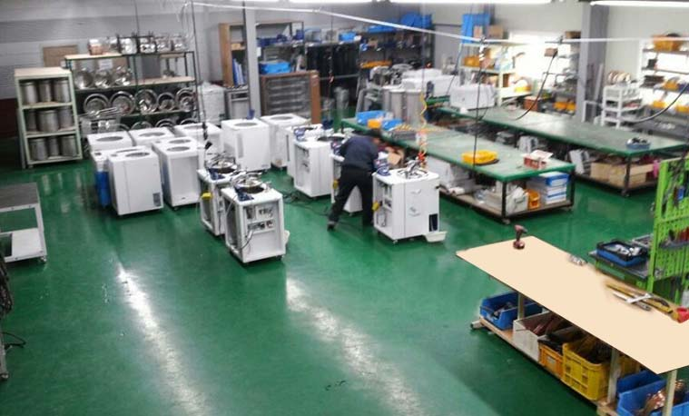
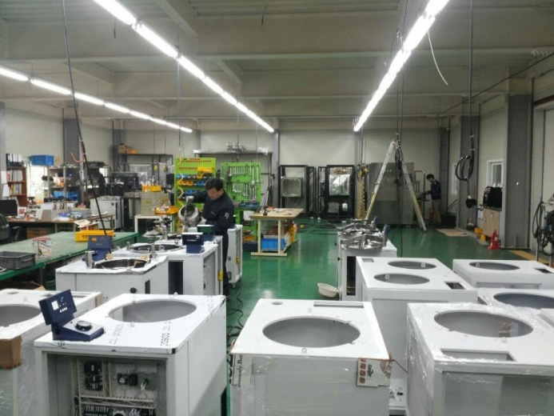
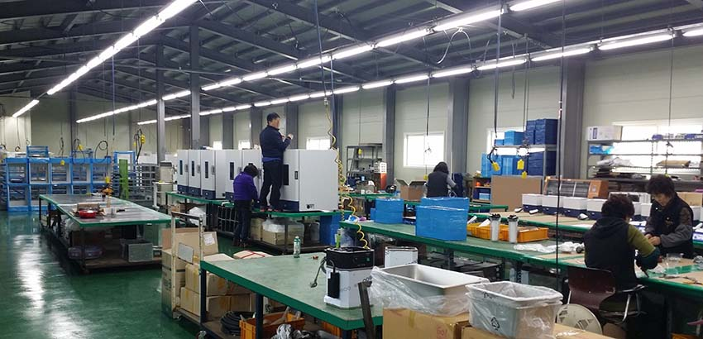
- 본사 제 2공장 DAIHAN LABTECH CO., LTD.

Slide 7
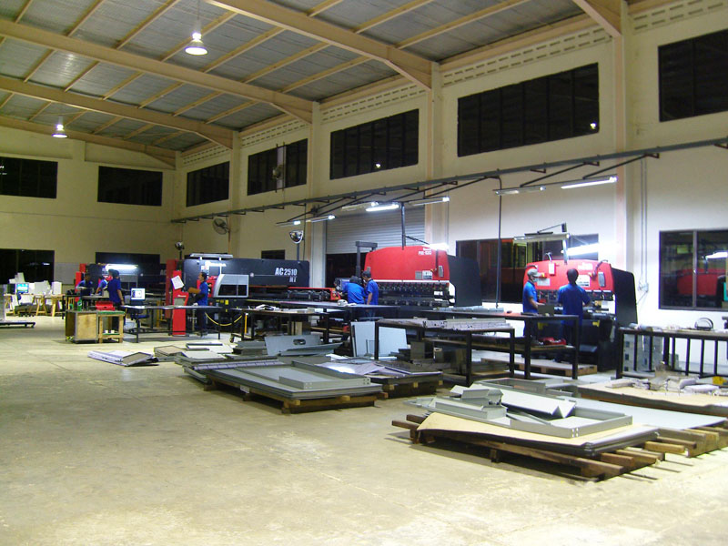
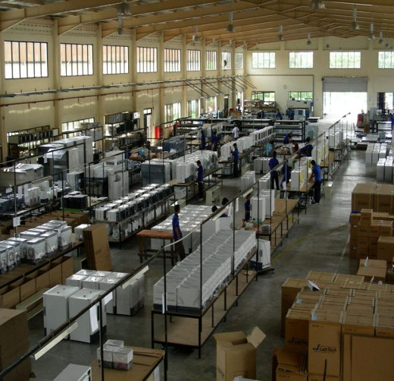
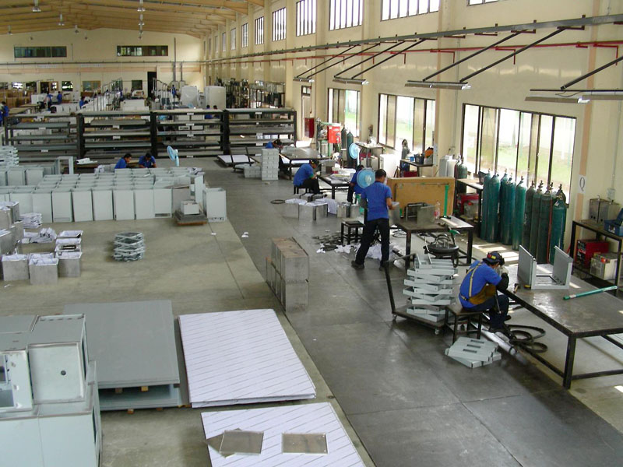
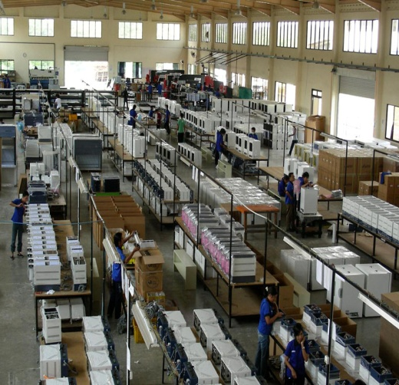
NCT / Assembly
인도네시아 제 2공장
PT. DAIHAN LABTECH

Slide 8
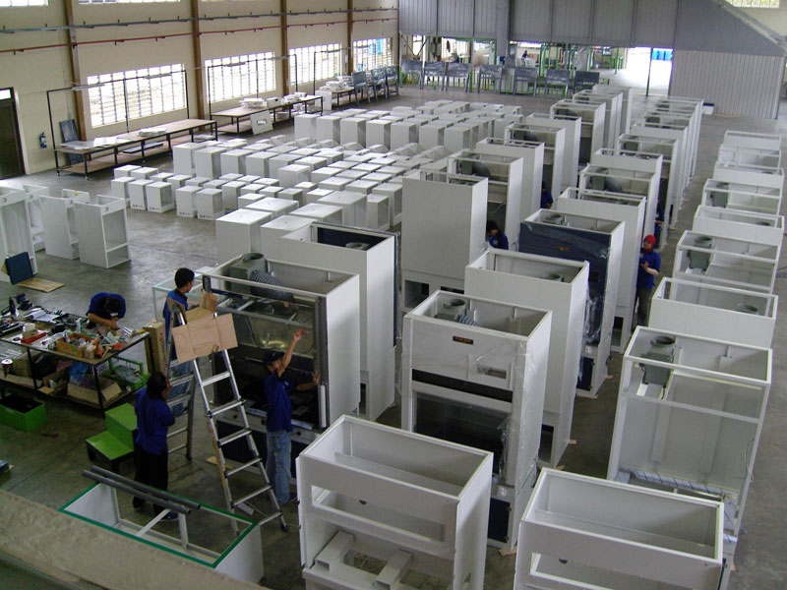
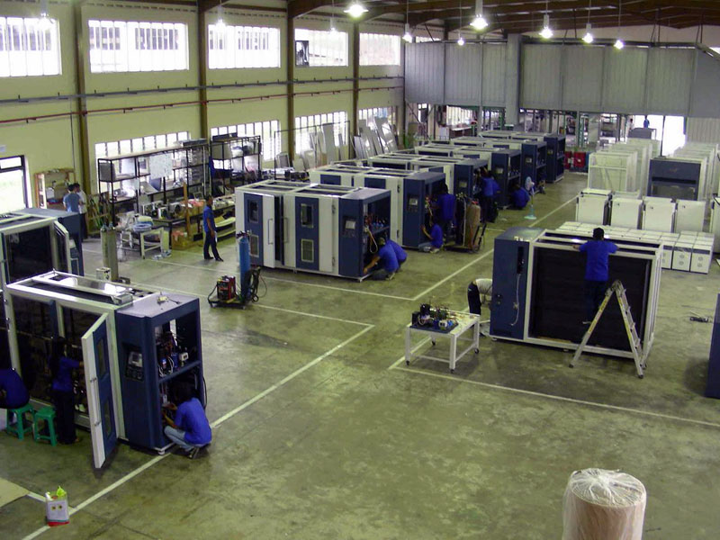
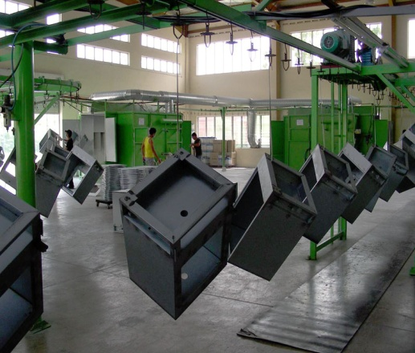
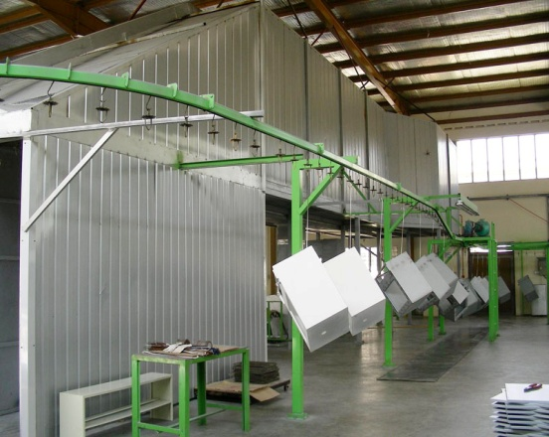
Powder Coating
/ Assembly
인도네시아 제 2공장
PT. DAIHAN LABTECH

Slide 9
회사 연혁
Notes:
Custom animation effects: faded zoom and rise up
(Basic)
To reproduce the background on this slide, do the following:
On the Design tab, in the Background group, click the arrow next to Background Styles, and then click Style 8 (second row, fourth option from the left).
Note: If this action is taken in a PowerPoint presentation containing more than one slide, the background style will be applied to all the slides.
To reproduce the text effects on this slide, do the following:
On the Home tab, in the Slides group, click Layout, and then click Blank.
On the Insert tab, in the Text group, click Text Box, and then on the slide, drag to draw the text box.
Enter text in the text box, select the text, and then on the Home tab, in the Font group, select Calibri from the Font list, enter 50 in the Font Size list, and then click Bold.
On the Home tab, in the Paragraph group, click Center to center the text.
With the text box still selected, under Drawing Tools, on the Format tab, in the WordArt Styles group, click Text Effects, point to Glow, and select Accent color 1, 5 pt glow (first row, first option from the left).
Under Drawing Tools, on the Format tab, in the WordArt Styles group, click Text Effects, point to Glow, point to More Glow Colors, and select Black, Text 1, Lighter 35% (third row, second option from the left).
Under Drawing Tools, on the Format tab, in the bottom right corner of the WordArt Styles group, click the Format Text Effects dialog box launcher. In the Format Text Effects dialog box, in the left pane, click Text Fill. In the Text Fill pane, select Solid Fill, click the button next to Color and select More Colors. In the Colors dialog box, on the Custom tab, enter values for Red: 116, Green: 216, Blue: 226.
Also in the Format Text Effects dialog box, in the left pane, click Shadow. In the Shadow pane, in the Presets list, under Inner click Inside Diagonal Top Right (first row, third option from the left), and then do the following:
Click the button next to Color, and then under Theme Colors select Black, Text 1 (first row, second option from the left).
In the Transparency box, enter 57%.
In the Blur box, enter 2 pt.
Also in the Format Text Effects dialog box, in the left pane, click 3-D Format. In the 3-D Format pane, do the following:
Under Bevel, click the button next to Top, and then under Bevel click Circle (first row, first option from the left). Next to Top, in the Width box, enter 2.2 pt, and in the Height box, enter 1 pt.
Under Depth, click the button next to Color, and then click Automatic.
Under Contour, click the button next to Color, and then click More Colors. In the Colors dialog box, on the Custom tab, enter values for Red: 221, Green: 221, Blue: 221.
Under Surface, click the button next to Material, and then under Standard click Warm Matte (second option from the left). Click the button next to Lighting, and then under Neutral click Soft (first row, third option from the left). In the Angle box, enter 180°.
To reproduce the animation effects on this slide, do the following:
On the Animations tab, in the Animations group, click Custom Animation.
On the slide, select the text box. In the Custom Animation task pane, do the following:
Click Add Effect, point to Entrance, and then click More Effects. In the Add Entrance Effect dialog box, under Subtle, click Faded Zoom.
Select the animation effect (faded zoom effect for the text box). Under Modify: Faded Zoom, do the following:
In the Start list, select With Previous.
In the Speed list, select Fast.
On the slide, select the text box. In the Custom Animation task pane, do the following:
Click Add Effect, point to Entrance, and then click More Effects. In the Add Entrance Effect dialog box, under Moderate, click Rise Up.
Select the second animation effect (rise-up effect for the text box). Under Modify: Rise Up, do the following:
In the Start list, select With Previous.
In the Speed list, select Fast.

Slide 10
회사 연혁
1992.08 대한랩테크 무역상사 창업
1994.05 과학기기 수출 시장 개척
1996.06 LABTECH 상표등록
1998.01 ㈜대한랩테크 법인전환
1998.09 공장등록. 제조업으로 전환 2000.02 ISO 9001 EAQA, CE 마크 인증
KSA9001:2001

Slide 11
2002.01 ㈜대한랩테크 공장 신축이전
2002.09 의료/연구실험장비 관리장치
특허등록
2003.08 경기도 유망중소기업으로 선정
2004.11 백만 불 수출탑 수상
2005.04 기업부설 연구소 설립
㈜대한랩테크 싱가폴 현지법인 설립

Slide 12
2005.09 ㈜대한정밀 NCT판금 사업부 설립
2006.01 의료기기 제조업 허가 (식약청)
ISO 13485 및 GMP 인증 획득
2006.07 대표이사 경기 동부 상공회의소
2대 의원 역임
2006.11 삼백만 불 수출탑 달성
2007.11 한국무역협회 4회
한국을 빛낸 이달의 무역인상 수상

Slide 13
2007.11 오백만 불 수출탑 수상
2008.01 인도네시아 바탐 현지공장 설립
2008.02 인도네시아 현지 공장 확장
FULLY EQUIPED FACTORY SYSTEM
2008.03 Lab Metal Furniture 사업부 런칭
2008.07 제3회 경기동부상공 경영대상
2009.01 인도 제3 공장/현지 법인 설립

Slide 14
2009.07 대표이사 경기 동부 상공회의소
3대 의원 역임
2009.11 천만 불 수출탑 수상
2010.02 상도 오토클레이브 인수
2010.06 초저온 냉동고 개발 & 생산
2011.02 대형 멸균기 개발 & 생산

Slide 15
2011.03 (구)대한정밀, ㈜에스티엘로 법인 전환
2012.10 잠비아 영부인 방문
2013.04 PLASMA AUTOCLAVE 개발 착수
2015.12 신축공장 공사 완료
2015.12 경기중소기업 수출 우수기업 수상
2015.12 경기도 여성고용 우수기업 수상

Slide 16
조 직 도
Notes:
Custom animation effects: fly by letter
(Basic)
To reproduce the text effects on this slide, do the following:
On the Home tab, in the Slides group, click Layout, and then click Blank.
On the Insert tab, in the Text group, click Text Box, and then on the slide, drag to draw the text box.
Enter text in the text box, select the text, and then on the Home tab, in the Font group, select Corbel from the Font list, enter 50 in the Font Size list, and click Bold.
On the Home tab, in the Paragraph group, click Center to center the text.
Select the text box. Under Drawing Tools, on the Format tab, in the WordArt Styles, click the Format Text Effects: Text Box dialog box launcher. In the Format Text Effects dialog box, in the left pane, click Text Fill.
In the Text Fill pane, select Solid Fill, and in the Color list, select Olive Green, Accent 3 (first row, seventh option from the left).
Also in the Format Text Effects dialog box, in the left pane, click 3-D Format. In the 3-D Format pane, do the following:
Under Bevel, click the button next to Top, and then under Bevel click Angle (second row, first option from the left). Next to Top, in the Width box, enter 1.5 pt, and in the Height box, enter 1.5 pt.
Under Depth, click the button next to Color, and then click Automatic. In the Depth box, enter 2.5 pt.
Under Contour, click the button next to Color, and then under Theme Colors click Olive Green, Accent 3 (first row, seventh option from the left).
Under Surface, click the button next to Material, and then under Translucent click Powder (first option from the left). Click the button next to Lighting, and then under Special click Flat (first option from the left). In the Angle box, enter 315°.
On the slide, select the text box. On the Home tab, in the Drawing group, click Arrange, point to Align, and then do the following:
Click Align to Slide.
Click Align Middle.
Click Align Center.
To reproduce the animation effects on this slide, do the following:
On the Animations tab, in the Animations group, click Custom Animation.
On the slide, select the text box. In the Custom Animation task pane, do the following:
Click Add Effect, point to Entrance, and then click More Effects. In the Add Entrance Effect dialog box, under Basic, click Fly In.
Select the animation effect (fly-in effect for the text box). Click the arrow to the right of the selected effect, and then click Effect Options. In the Fly In dialog box, do the following:
On the Effect tab, do the following:
In the Direction list, select From Left.
In the Animate Text list, select By Letters.
In the % delay between letters box, enter 6.
On the Timing tab, do the following:
In the Start list, select With Previous.
In the Speed list, select 1 seconds (Fast).
On the slide, select the text box. In the Custom Animation task pane, do the following:
Click Add Effect, point to Exit, and then click More Effects. In the Add Exit Effect dialog box, under Basic, click Fly Out.
Select the second animation effect (fly-out effect for the text box). Click the arrow to the right of the selected effect, and then click Effect Options. In the Fly Out dialog box, do the following:
On the Effect tab, do the following:
In the Direction list, select To Right.
In the Animate Text list, select By Letters.
In the % delay between letters box, enter 6.
On the Timing tab, do the following:
In the Start list, select After Previous.
In the Delay box, enter 1.5.
In the Speed list, select 1 seconds (Fast).
To reproduce the background on this slide, do the following:
Right-click the slide background area, and then click Format Background. In the Format Background dialog box, click Fill in the left pane, select Gradient fill in the Fill pane, and then do the following:
In the Type list, select Radial.
Click the button next to Direction, and then click From Center (third option from the left).
Under Gradient stops, click Add or Remove until two stops appear in the drop-down list.
Also under Gradient stops, customize the gradient stops that you added as follows:
Select Stop 1 from the list, and then do the following:
In the Stop position box, enter 0%.
Click the button next to Color, and then under Theme Colors click Black, Text 1, Lighter 50% (second row, second option from the left).
Select Stop 2 from the list, and then do the following:
In the Stop position box, enter 100%.
Click the button next to Color, and then under Theme Colors click Black, Text 1 (first row, second option from the left).

Slide 17
대표이사
기업부설연구소
품질관리위원회
경영지원팀
영업&마케팅팀
생산기술팀
품질관리팀
판금사업팀
경영지원팀
자재/출고팀
국내마케팅팀
해외마케팅팀
기술영업팀
랩장비 사업부
냉장냉동챔버 사업부
바이오메디칼 사업부
품질관리팀
서비스팀
(주)에스티엘
(구.대한정밀)

Slide 18
제조 사업부 소개

Slide 19
랩장비 사업부 – ISO9001
Water Bath
Distiller
Water Bath / Shaking Water Bath / Oil Bath
Hotplate / Stirrer
Micro Centrifuge
Hotplate / Magnetic Stirrer / Hotplate Stirrer
Dry Block Heater
Oven
General Oven
Vacuum Drying Oven
Cooling Refrigerator Bath / Chiller
Water Still
Micro Centrifuge
Incubator
Shaking Incubator
General Incubator
Low Temp. BOD Incubator
Air Jacket CO2 Incubator
Shaking Incubator

Slide 20
랩장비 사업부 – ISO9001
Forced Convection Oven
Up to 250’C
Glass Baking Oven
Ideal for Baking of Glass and any kinds of Sheets or Plates
Cart Oven
With Heavy Duty Movable Carts
Cure and Inert Oven
Cure for Manufacturing process of BGA/CSP Flip Chip
Up to 1400L Capacity
Clean Air Oven
Class 100 Hi-Clean Oven (up to 200’C)
Jumbo Vacuum Drying Oven
10 to 760 Torr
Aging Test Oven
Up to 250’C / 350’C
Adjustable Air Vent System
Built-in Removable Geared Rotator

Slide 21
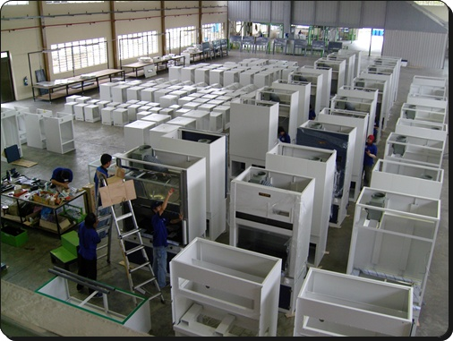
랩장비 사업부 – ISO9001
Fume Hood
1200 / 1500 / 1800 mm
Laminar Flow Clean Bench
Horizontal / Vertical Type
Bio Hazard Safety Clean Bench
Class II A2 / B2 Type Available
Air Velocity Control & Alarm (Option)
Air Velocity Control & Alarm (Option)
ULPA filter (Option)
Air Velocity Control & Alarm (Standard)
Production Line
- Fume Hood

Slide 22
바이오메디칼 사업부 – ISO9001 / ISO13485
Blood Bank Refrigerator /
Pharmaceutical Refrigerator
7 days Chart Recorder
Refrigerator / Freezer
Laboratory Refrigerator
Refrigerator / Freezer (Combination)
Bio Medical Freezer
Up to -35’C
Battery Back up System
STS Drawer Shelf
Laboratory Freezer
Non CFC / HCFC Refrigerant System
295L / 612L / 1125L Available
국내 녹십자 : 신종 Influenza 백신개발에 자사제품사용
KFDA 제조 허가
CANADA OSS project U$646,700
Deep Freezer
Up to -85’C (Upright / Chest Type Available)
Non CFC / HCFC Refrigerant System

Slide 23
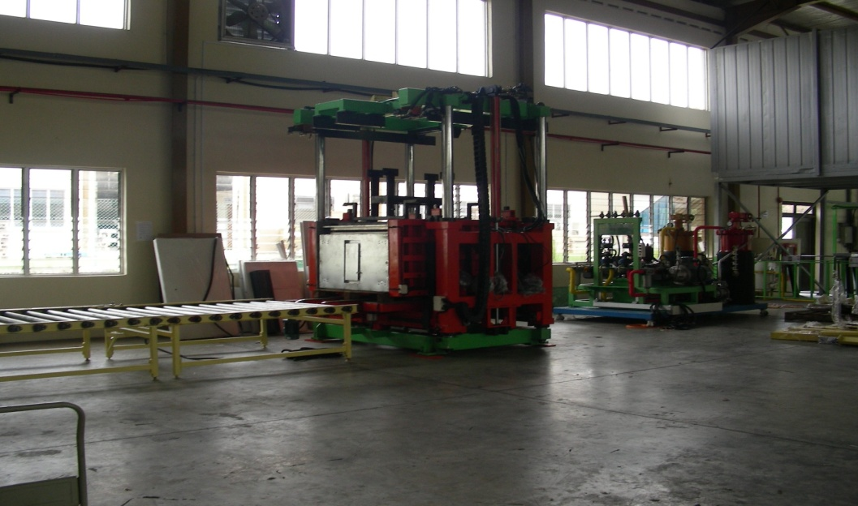
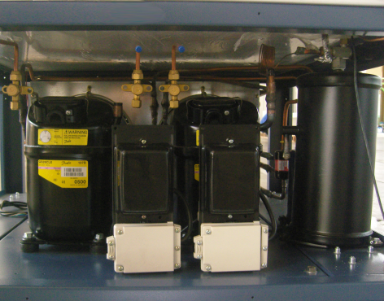
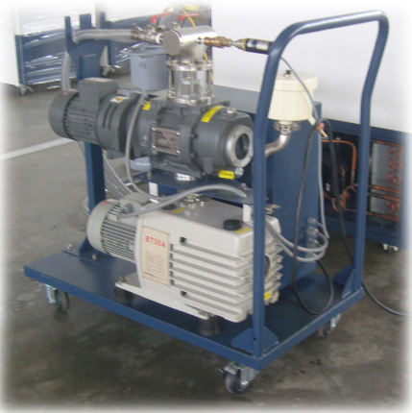
바이오메디칼 사업부- 생산 설비
High Pressure
PU Injection Line
Turbo Vacuum
System
Cascade Refrigeration System
with Natural Refrigerant
Notes:
Transition effect for split picture, slide 1
(Basic)
Tip: Use this template with a cropped picture and reveal the rest of the picture on the next slide.
To reproduce the picture and text effects on this slide, do the following:
On the Home tab, in the Slides group, click Layout, and then click Blank.
On the Insert tab, in the Illustrations group, click Picture, select a picture, and then click Insert.
Under Picture Tools, on the Format tab, in the bottom right corner of the Size group, click the Size and Position dialog box launcher. In the Size and Position dialog box, on the Size tab, under Crop from, enter a value into the Right box to crop the picture so that under Size and rotate, the value in the Width box changes to 5”.
On the Home tab, in the Drawing group, click Arrange, point to Align, and then do the following:
Click Align to Slide.
Click Align Right.
On the Insert tab, in the Text group, click Text Box, and then on the slide, drag to draw the text box.
Enter text in the text box, select the text, and then on the Home tab, in the Font group, select Calibri from the Font list, select 24 from the Font Size list, click the arrow next to Font Color, and then under Theme Colors click White, Background 1, Darker 35% (fifth row, first option from the left).
On the Home tab, in the Paragraph group, click Center to center the text in the text box.
Drag the text box to the left of the picture.
Select the text box. On the Home tab, in the Drawing group, click Arrange, point to Align, and then do the following:
Click Align to Slide.
Click Align Middle.
To reproduce the transition and background effects on this slide, do the following:
On the Animations tab, in the Transition to This Slide group, click More, and then under Wipes, click Split Vertical In.
Right-click the slide background area, and then click Format Background. In the Format Background dialog box, in the left pane, click Fill. In the Fill pane, select Solid fill, click the button next to Color, and then under Theme Colors click Dark Blue, Text 2, Darker 50% (sixth row, fourth option from the left).

Slide 24
바이오메디칼 사업부 – ISO9001 / ISO13485
Large Capacity
Autoclave /
Steam Sterilizer
Bench Top / Square Chamber Type
Front Loading Type
Bench Top / Round Chamber Type
Vertical Type
Autoclave /
Steam Sterilizer
Pass-Through (Double Door) Type (300L / 500L)
Large Steam Sterilizer (200L / 300L)

Slide 25
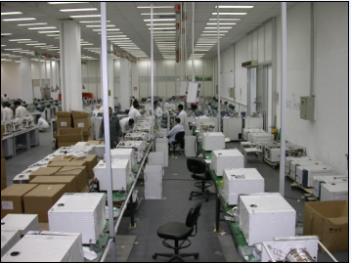
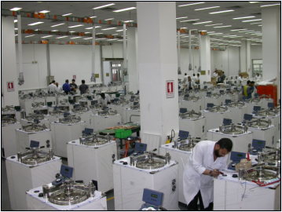
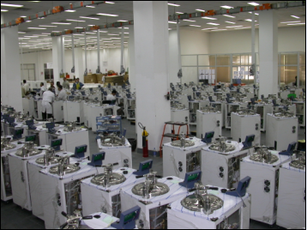
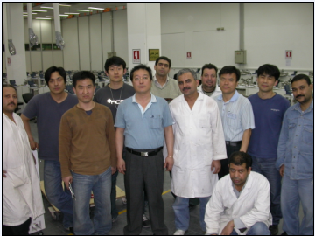
이집트 : 보건부(정부)에 멸균기 다년간 단독 공급 중 – U$11,400,000.00

Slide 26
냉장냉동챔버 사업부 – ISO9001
Plant Growth Chamber
0’C to 60’C / 30% to 98% RH
Universal Growth Chamber
Eco-Green Real Environmental of Earth
Giant / Walk-in Environmental Chamber
Eco-Green Real Environmental of Earth
Environment Growth Room
Your Own Earth Planet with PU Insulated Structure
CO2 / Illumination Control (Option)
Lab-Dog DVR / Mobile Alert System (Option)
295L / 612L / 1125L Available
Illumination (0 to 35000 lux)
Temperature ( 0’C to 60’C)
Humidity (30% to 98% RH)
Illumination (0 to 35000 lux)
Temperature (0’C to 60’C)
Humidity (30% to 98% RH)
Wind Velocity (0.3m/sec to 1.0/sec)

Slide 27
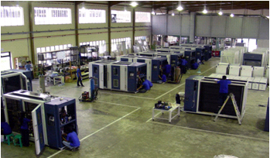
냉장냉동챔버 사업부 – ISO9001
Thermal Shock Tester
Hot / Cold 2 Zone Chamber
Temp. & Humi. Chamber
-50’C to 150’C (Option : 180’C)
ICH Test Chamber
0’C to 60’C / 30% to 98% RH
Giant / Walk-in Test Chamber & Room
Your Own Testing Laboratory
-70’C to 200’C
20% to 98% RH
Production Line
- Test Chamber

Slide 28
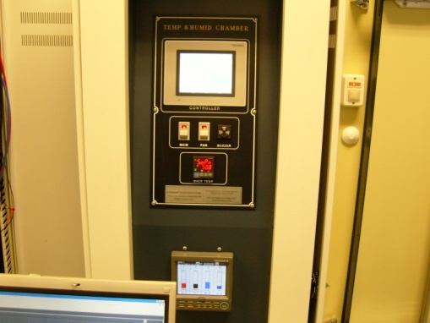
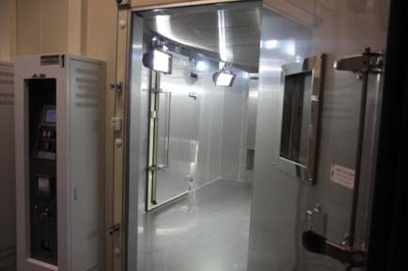
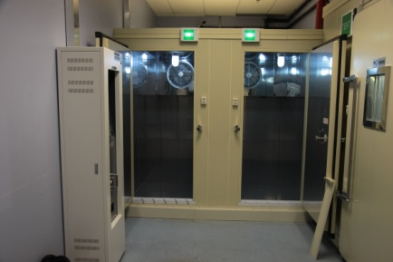
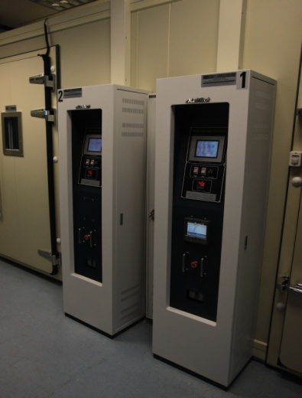
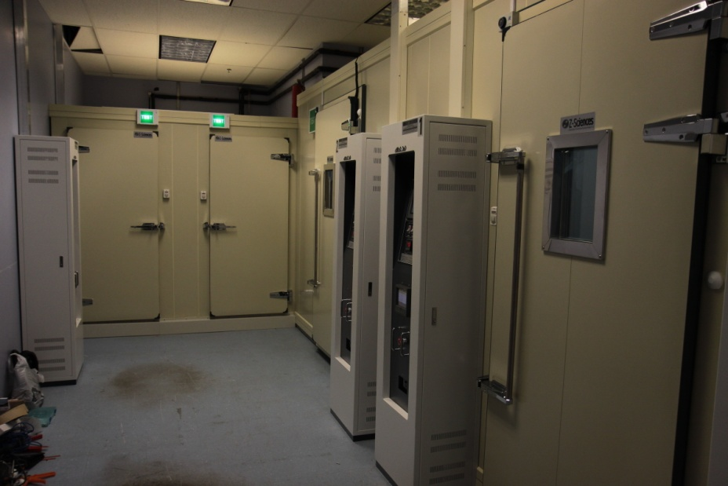
캐나다 : 농림부(정부)에 항온항습 챔버 다년간 단독 공급 중 - U$800,000.00

Slide 29
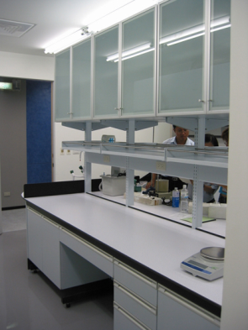
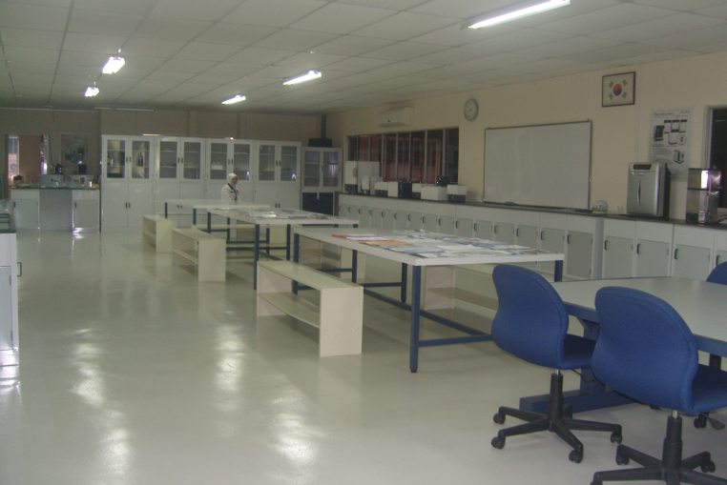
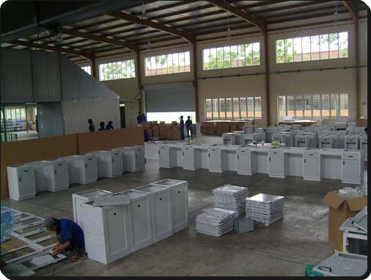
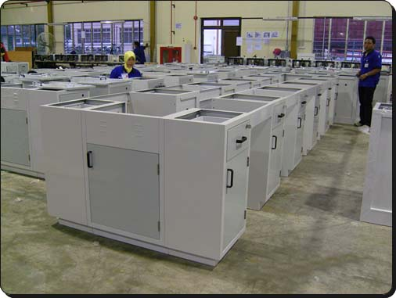
랩 메탈 퍼니쳐
Modular Bench
Your Design / Color / Material
Frame Bench
Your Design / Color / Material
Sink / Shelf / Rack / Cabinet / Drawer
Your Design / Color
C / H Frame Wall / Island Bench
인도네시아 2공장 내부
Production Line
- Lab Metal Furniture

Slide 30
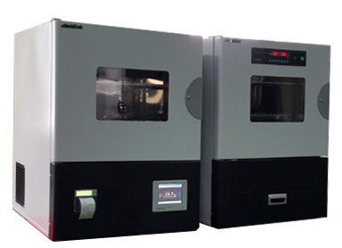
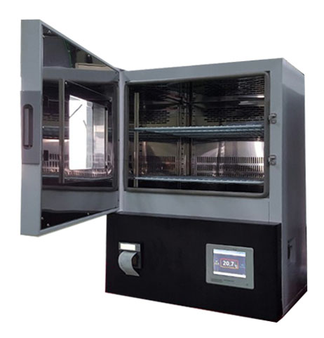
2016년 신제품 소개
LBI-100E
LSI-150M

Slide 31
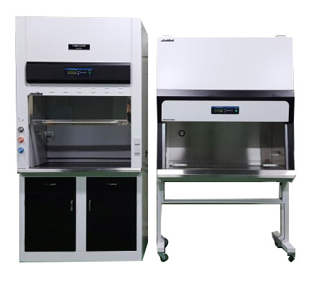
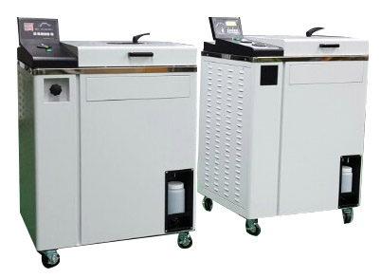
2016년 신제품 소개
LFH-2120V
LCB-0123B-A2
LAC-5040SD
LAC-5045SP

Slide 32
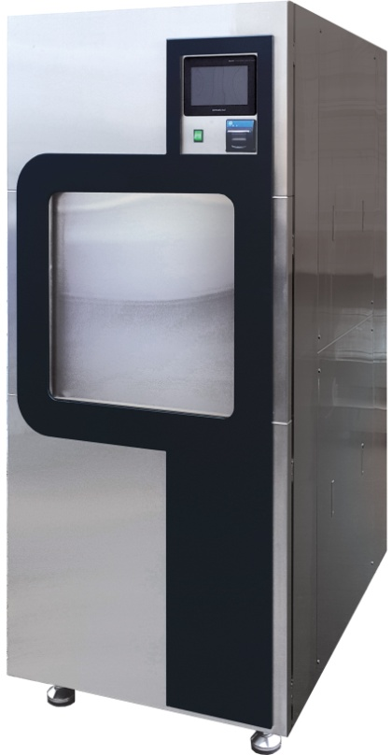
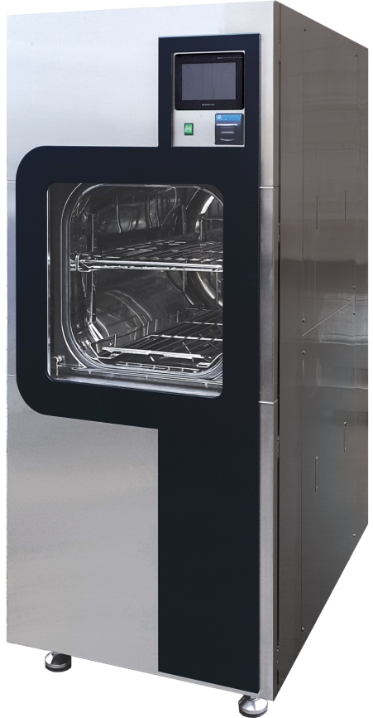
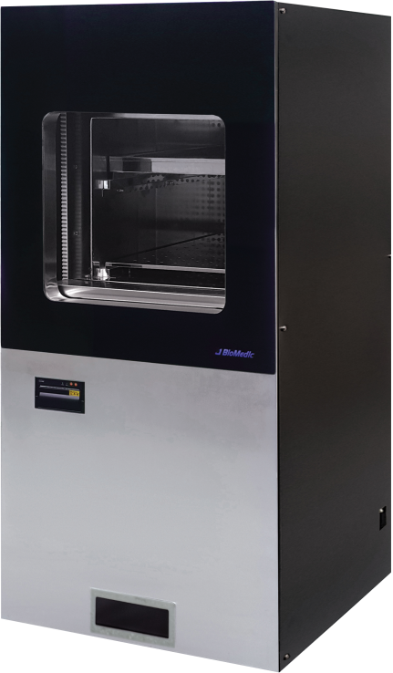
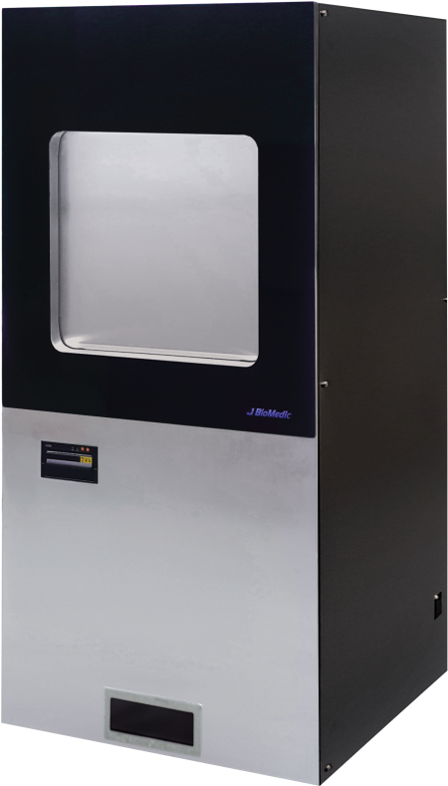
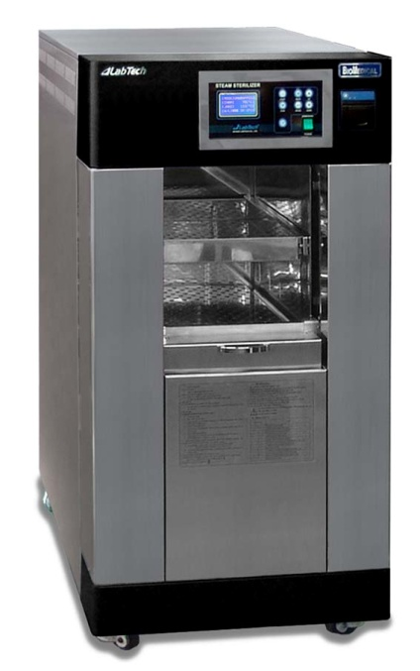
2016년 신제품 소개
LAC-6205SP
LAC-6065RSP
LPS-1130F

Slide 33
비 전
기술
지속적인 R&D
마케팅
시장조사
서비스
장기적 A/S 관리
품질
QC 철저
고객요구파악
기술 영업 실현
Trouble Shooting ->서비스 메뉴얼
A/S 감소
시장요구 기술의 실현
첨단 기술의 간편화
제품의 표준화 및 국제 규격화
전략적 홍보 기획
브랜드 선호도 구축
브랜도 인지도 향상
브랜드 입지 구축
브랜드 대중화
Notes:
Custom animation effects: fly-in and shrink lines, stretch rectangles
(Intermediate)
To reproduce the first vertical line on this slide, do the following:
On the Home tab, in the Slides group, click Layout, and then click Blank.
On the Home tab, in the Drawing group, click Shapes, and then under Lines click Line. On the slide, press and hold SHIFT, and then drag to draw a straight, vertical line.
Under Drawing Tools, on the Format tab, in the Size group, in the Shape Width box, enter 4.5”.
On the Home tab, in the bottom right corner of the Drawing group, click the Format Shape dialog box launcher. In the Format Shape dialog box, click Line Color in the left pane, select Gradient fill in the Line Color pane, and then do the following:
In the Type list, select Linear.
Click the button next to Direction, and then click Linear Right (first row, fourth option from the left).
In the Angle box, enter 0°.
Under Gradient stops, click Add or Remove until three stops appear in the drop-down list.
Also under Gradient stops, customize the gradient stops that you added as follows:
Select Stop 1 from the list, and then do the following:
In the Stop position box, enter 0%.
Click the button next to Color, select More Colors, and then in the Colors dialog box, on the Custom tab, enter values for Red: 148, Green: 172, and Blue: 208.
In the Transparency box, enter 100%.
Select Stop 2 from the list, and then do the following:
In the Stop position box, enter 50%.
Click the button next to Color, select More Colors, and then in the Colors dialog box, on the Custom tab, enter values for Red: 148, Green: 172, and Blue: 208.
In the Transparency box, enter 0%.
Select Stop 3 from the list, and then do the following:
In the Stop position box, enter 99%.
Click the button next to Color, select More Colors, and then in the Colors dialog box, on the Custom tab, enter values for Red: 148, Green: 172, and Blue: 208.
In the Transparency box, enter 100%.
Also in the Format Shape dialog box, click Line Style in the left pane. In the Line Style pane, in the Width box, enter 6 pt.
To reproduce the first rectangle on this slide, do the following:
On the Home tab, in the Drawing group, click Shapes, and then under Rectangles click Rectangle (first option from the left). On the slide, drag to draw a rectangle.
Select the rectangle. Under Drawing Tools, on the Format tab, in the Size group, do the following:
In the Shape Height box, enter 2”.
In the Shape Width box, enter 2”.
Under Drawing Tools, on the Format tab, in the bottom right corner of the Shape Styles group, click the Format Shape dialog box launcher. In the Format Shape dialog box, click Fill in the left pane, select Gradient fill in the Fill pane, and then do the following:
In the Type list, select Linear.
Click the button next to Direction, and then click Linear Up (second row, second option from the left).
In the Angle box, enter 270°.
Under Gradient stops, click Add or Remove until three stops appear in the drop-down list.
Also under Gradient stops, customize the gradient stops that you added as follows:
Select Stop 1 from the list, and then do the following:
In the Stop position box, enter 0%.
Click the button next to Color, click More Colors, and then in the Colors dialog box, on the Custom tab, enter values for Red: 44, Green: 93, and Blue: 152.
In the Transparency box, enter 0%.
Select Stop 2 from the list, and then do the following:
In the Stop position box, enter 80%.
Click the button next to Color, click More Colors, and then in the Colors dialog box, on the Custom tab, enter values for Red: 60, Green: 123, Blue: 199.
In the Transparency box, enter 0%.
Select Stop 3 from the list, and then do the following:
In the Stop position box, enter 100%.
Click the button next to Color, click More Colors, and then in the Colors dialog box, on the Custom tab, enter values for Red: 58, Green: 124, Blue: 203.
In the Transparency box, enter 0%.
Also in the Format Shape dialog box, click Line Color in the left pane. In the Line Color pane, select No line.
Also in the Format Shape dialog box, click 3-D Format in the left pane, and in the 3-D Format pane, do the following:
Under Bevel, click the button next to Top, and then under Bevel click Circle (first row, first option from the left). Next to Top, in the Width box, enter 5 pt, and in the Height box, enter 2 pt.
Under Surface, in the Angle box, enter 20°.
On the slide, right-click the rectangle and then click Edit Text.
Enter text in the text box and select the text. On the Home tab, in the Font group, do the following:
In the Font list, select Calibri.
In the Font Size list, select 32.
Click the button next to Font Color, and then under Theme Colors click White, Background 1 (first row, first option from the left).
On the slide, press and hold CTRL, and then select the line and the rectangle.
On the Home tab, in the Drawing group, click Arrange, point to Align, and then do the following:
Click Align Selected Objects.
Click Align Left.
With the line and rectangle still selected, drag them to the left side of the slide.
To reproduce the animation effects for the first vertical line and rectangle on this slide, do the following:
On the Animations tab, in the Animations group, click Custom Animation.
On the slide, select the line. In the Custom Animation task pane, do the following:
Click Add Effect, point to Entrance, and then click More Effects. In the Add Entrance Effect dialog box, under Basic, click Fly In.
Select the first animation effect (fly-in effect for the line), and then under Modify: Fly In, do the following:
In the Start list, select With Previous.
In the Direction list, select From Top.
In the Speed list, select Fast.
On the slide, select the line. In the Custom Animation task pane, do the following:
Click Add Effect, point to Emphasis, and then click More Effects. In the Add Emphasis Effect dialog box, under Basic, click Grow/Shrink.
Select the second animation effect (grow/shrink effect for the line). Click the arrow to the right of the effect, and then click Effect Options. In the Grow/Shrink dialog box, do the following:
On the Effect tab, do the following:
In the Size list, select Tiny.
Also in the Size list, select Vertical.
On the Timing tab, do the following:
In the Start list, select With Previous.
In the Delay box, enter 0.5.
In the Speed list, select 1 seconds (Fast).
On the slide, select the rectangle. In the Custom Animation task pane, do the following:
Click Add Effect, point to Entrance, and then click More Effects. In the Add Entrance Effect dialog box, under Moderate, click Stretch.
Select the third animation effect (stretch effect for the rectangle), and then under Modify: Stretch, do the following:
In the Start list, select After Previous.
In the Direction list, select From Left.
In the Speed list, select Fast.
To reproduce the other shapes with animation effects on this slide, do the following:
On the slide, press and hold CTRL, and then select the rectangle and the line. On the Home tab, in the Clipboard group, click the arrow under Paste, and then click Duplicate.
On the slide, drag the second line and rectangle to the center of the slide.
With the second line and rectangle still selected, on the Home tab, in the Clipboard group, click the arrow under Paste, and then click Duplicate.
On the slide, drag the third line and rectangle to the right side of the slide.
On the slide, press CTRL+A to select all the objects. On the Home tab, in the Drawing group, click Arrange, point to Align, and then do the following:
Click Align to Slide.
Click Align Middle.
Click the text in each of the duplicate rectangles, and then edit the text.
On the slide, select the second (middle) line. On the Home tab, in the bottom right corner of the Drawing group, click the Format Shape dialog box launcher. In the Format Shape dialog box, click Line Color in the left pane, select Gradient fill in the Line Color pane, and then do the following:
In the Type list, select Linear.
Click the button next to Direction, and then click Linear Right (first row, fourth option from the left).
In the Angle box, enter 0°.
Under Gradient stops, click Add or Remove until three stops appear in the drop-down list.
Also under Gradient stops, customize the gradient stops that you added as follows:
Select Stop 1 from the list, and then do the following:
In the Stop position box, enter 0%.
Click the button next to Color, select More Colors, and then in the Colors dialog box, on the Custom tab, enter values for Red: 154, Green: 181, Blue: 228.
In the Transparency box, enter 100%.
Select Stop 2 from the list, and then do the following:
In the Stop position box, enter 50%.
Click the button next to Color, and then under Theme Colors click White, Background 1, Darker 25% (fourth row, first option from the left).
In the Transparency box, enter 0%.
Select Stop 3 from the list, and then do the following:
In the Stop position box, enter 99%.
Click the button next to Color, and then under Theme Colors click White, Background 1, Darker 25% (fourth row, first option from the left).
In the Transparency box, enter 100%.
On the slide, select the second (middle) rectangle. On the Home tab, in the bottom right corner of the Drawing group, click the Format Shape dialog box launcher. In the Format Shape dialog box, click Fill in the left pane, select Gradient fill in the Fill pane, and then do the following:
In the Type list, select Linear.
Click the button next to Direction, and then click Linear Up (second row, second option from the left).
In the Angle box, enter 270°.
Under Gradient stops, click Add or Remove until three stops appear in the drop-down list.
Also under Gradient stops, customize the gradient stops that you added as follows:
Select Stop 1 from the list, and then do the following:
In the Stop position box, enter 0%.
Click the button next to Color, click More Colors, and then in the Colors dialog box, on the Custom tab, enter values for Red: 118, Green: 149, Blue: 53.
Select Stop 2 from the list, and then do the following:
In the Stop position box, enter 80%.
Click the button next to Color, click More Colors, and then in the Colors dialog box, on the Custom tab, enter values for Red: 115, Green: 195, Blue: 72.
Select Stop 3 from the list, and then do the following:
In the Stop position box, enter 100%.
Click the button next to Color, click More Colors, and then in the Colors dialog box, on the Custom tab, enter values for Red: 156, Green: 199, Blue: 70.
On the slide, select the third (right) line. On the Home tab, in the bottom right corner of the Drawing group, click the Format Shape dialog box launcher. In the Format Shape dialog box, click Line Color in the left pane, select Gradient fill in the Line Color pane, and then do the following:
In the Type list, select Linear.
Click the button next to Direction, and then click Linear Right (first row, fourth option from the left).
In the Angle box, enter 0°.
Under Gradient stops, click Add or Remove until three stops appear in the drop-down list.
Also under Gradient stops, customize the gradient stops that you added as follows:
Select Stop 1 from the list, and then do the following:
In the Stop position box, enter 0%.
Click the button next to Color, and then under Theme Colors click Aqua, Accent 5, Lighter 40% (fourth row, ninth option from the left).
In the Transparency box, enter 100%.
Select Stop 2 from the list, and then do the following:
In the Stop position box, enter 50%.
Click the button next to Color, and then under Theme Colors click Aqua, Accent 5, Lighter 40% (fourth row, ninth option from the left).
In the Transparency box, enter 0%.
Select Stop 3 from the list, and then do the following:
In the Stop position box, enter 99%.
Click the button next to Color, and then under Theme Colors click Aqua, Accent 5, Lighter 40% (fourth row, ninth option from the left).
In the Transparency box, enter 100%.
On the slide, select the third (right) rectangle. On the Home tab, in the bottom right corner of the Drawing group, click the Format Shape dialog box launcher. In the Format Shape dialog box, click Fill in the left pane, select Gradient fill in the Fill pane, and then do the following:
In the Type list, select Linear.
Click the button next to Direction, and then click Linear Up (second row, second option from the left).
In the Angle box, enter 270°.
Under Gradient stops, click Add or Remove until three stops appear in the drop-down list.
Also under Gradient stops, customize the gradient stops that you added as follows:
Select Stop 1 from the list, and then do the following:
In the Stop position box, enter 0%.
Click the button next to Color, select More Colors, and then in the Colors dialog box, on the Custom tab, enter values for Red: 39, Green: 135, Blue: 160.
Select Stop 2 from the list, and then do the following:
In the Stop position box, enter 80%.
Click the button next to Color, select More Colors, and then in the Colors dialog box, on the Custom tab, enter values for Red: 54, Green: 177, Blue: 210.
Select Stop 3 from the list, and then do the following:
In the Stop position box, enter 100%.
Click the button next to Color, select More Colors, and then in the Colors dialog box, on the Custom tab, enter values for Red: 52, Green: 179, Blue: 214.
To reproduce the background effects on this slide, do the following:
Right-click the slide background area, and then click Format Background. In the Format Background dialog box, click Fill in the left pane, select Gradient fill in the Fill pane, and then do the following:
In the Type list, select Radial.
Click the button next to Direction, and then click From Center (third option from the left).
Under Gradient stops, click Add or Remove until three stops appear in the drop-down list.
Also under Gradient stops, customize the gradient stops that you added as follows:
Select Stop 1 from the list, and then do the following:
In the Stop position box, enter 33%.
Click the button next to Color, and then under Theme Colors click White, Background 1 (first row, first option from the left).
Select Stop 2 from the list, and then do the following:
In the Stop position box, enter 67%.
Click the button next to Color, select More Colors, and then in the Colors dialog box, on the Custom tab, enter values for Red: 228, Green: 233, Blue: 236.
Select Stop 3 from the list, and then do the following:
In the Stop position box, enter 100%.
Click the button next to Color, select More Colors, and then in the Colors dialog box, on the Custom tab, enter values for Red: 178, Green: 186, Blue: 210.

Slide 34
마케팅 팀
서희원 팀장 010-3422-7524 sale@labtech.co.kr
바이오메디칼 사업부
최용석 팀장 010-3783-8016 biomedical@labtech.co.kr
랩장비 사업부
손경민 팀장 010-2505-5131 lab@labtech.co.kr
냉장냉동챔버 사업부
김영호 팀장 010-4740-7628 ref@labtech.co.kr

Slide 35
감사합니다.
Notes:
Custom animation effects: dotted line with text fade by letter
(Basic)
To reproduce the text effects on this slide, do the following:
On the Home tab, in the Slides group, click Layout, and then click Blank.
On the Insert tab, in the Text group, click Text Box, and then on the slide, drag to draw a text box that spans the entire width of the slide.
On the Insert tab, in the Text group, click Symbol. In the Symbol dialog box, do the following:
In the Font list, select (normal text).
In the Subset list, select General Punctuation.
In the Character Code box, enter 2022 to select BULLET, and then click Insert.
Click Insert 33 more times until there is a row of 34 bullets in the text box.
In the text box, select the text, and then on the Home tab, in the Font group do the following:
In the Font list, select Arial Black.
In the Font Size list, select 44.
Click the arrow next to Font Color, and then under Theme Colors click White, Background 1 (first row, first option from the left).
On the Home tab, in the Drawing group, click Arrange, point to Align, and then do the following:
Click Align to Slide.
Click Align Center.
Click Align Middle.
On the Insert tab, in the Text group, click Text Box. Drag to draw a text box on the slide.
Enter and select the text. On the Home tab, in the Font group, do the following:
In the Font list, select Corbel.
In the Font Size box, enter 50.
Click the arrow next to Font Color, and then under Theme Colors click White, Background 1 (first row, first option from the left).
Click Bold.
With the text still selected, on the Home tab, in the Paragraph group, click Center.
Select the second text box. On the Home tab, in the Drawing group, click Arrange, point to Align, and then do the following:
Click Align to Slide.
Click Align Center.
Click Align Middle.
To reproduce the background effects on this slide, do the following:
Right-click the slide background area, and then click Format Background. In the Format Background dialog box, click Fill in the left pane, select Gradient fill in the Fill pane, and then do the following:
In the Type list, select Radial.
Click the button next to Direction, and then click From Center (third option from the left).
Under Gradient stops, click Add or Remove until two stops appear in the drop-down list.
Also under Gradient stops, customize the gradient stops that you added as follows:
Select Stop 1 from the list, and then do the following:
In the Stop position box, enter 0%.
Click the button next to Color, and then under Theme Colors select Blue, Accent 1, Darker 25% (fifth row, fifth option from the left).
Select Stop 2 from the list, and then do the following:
In the Stop position box, enter 100%.
Click the button next to Color, and then under Theme Colors select Black, Text 1 (first row, second option from the left).
To reproduce the animation effects on this slide, do the following:
On the Animations tab, in the Animations group, click Custom Animation.
On the slide, select the first text box. In the Custom Animation task pane, do the following:
Click Add Effect, point to Entrance, and then click More Effects. In the Add Entrance Effect dialog box, under Basic, click Fly In.
Select the animation effect (fly-in effect for the first text box). Click the arrow to the right of the selected effect, and then click Effect Options. In the Fly In dialog box, do the following:
On the Effect tab, do the following:
In the Direction list, select From Left.
In the Animate text list, select By Letter.
In the % delay between letters box, enter 10.
On the Timing tab, do the following:
In the Start list, select With Previous.
In the Speed list, select 0.5 seconds (Very Fast).
On the slide, select the first text box. In the Custom Animation task pane, do the following:
Click Add Effect, point to Exit, and then click More Effects. In the Add Exit Effect dialog box, under Subtle, click Fade.
Select the second animation effect (fade effect for the first text box). Click the arrow to the right of the selected effect, and then click Effect Options. In the Fade dialog box, do the following:
On the Effect tab, do the following:
In the Animate text list, select By Letter.
In the % delay between letters box, enter 10.
On the Timing tab, do the following:
In the Start list, select With Previous.
In the Delay box, enter 1.5.
In the Speed list, select 0.5 seconds (Very Fast).
On the slide, select the second text box. In the Custom Animation task pane, do the following.
Click Add Effect, point to Entrance, and then click More Effects. In the Add Entrance Effect dialog box, under Subtle, click Fade.
Select the third animation effect (fade effect for the second text box). Click the arrow to the right of the selected effect, and then click Effect Options. In the Fade dialog box, do the following:
On the Effect tab, do the following:
In the Animate text list, select By Letter.
In the % delay between letters box, enter 6.
On the Timing tab, do the following:
In the Start list, select With Previous.
In the Delay box, enter 2.
In the Speed list, select 0.5 seconds (Very Fast).

